Slide 1
Update Xenxible Project Device Identifier
Syaziyah

Slide 2
UDPATE 10/07/2026

Slide 3
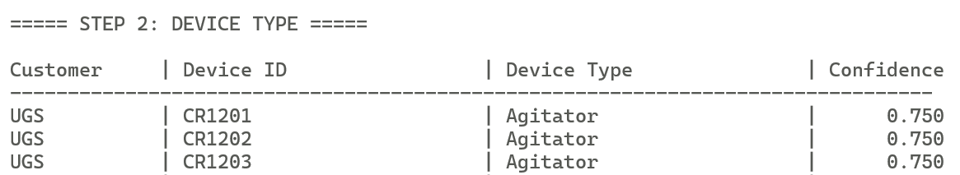
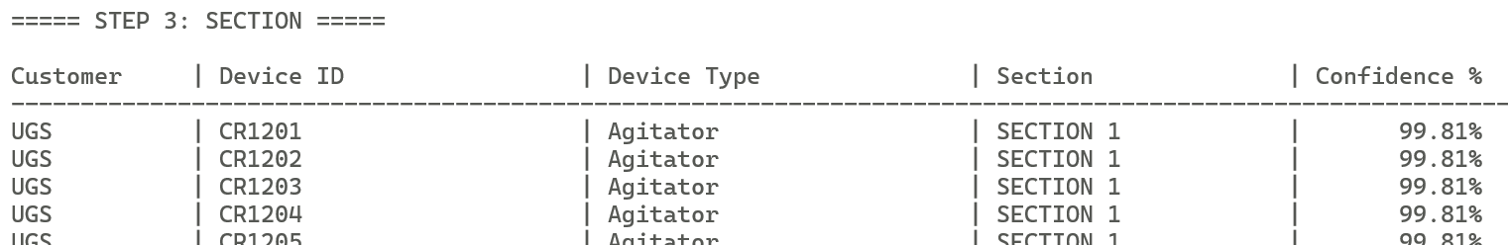
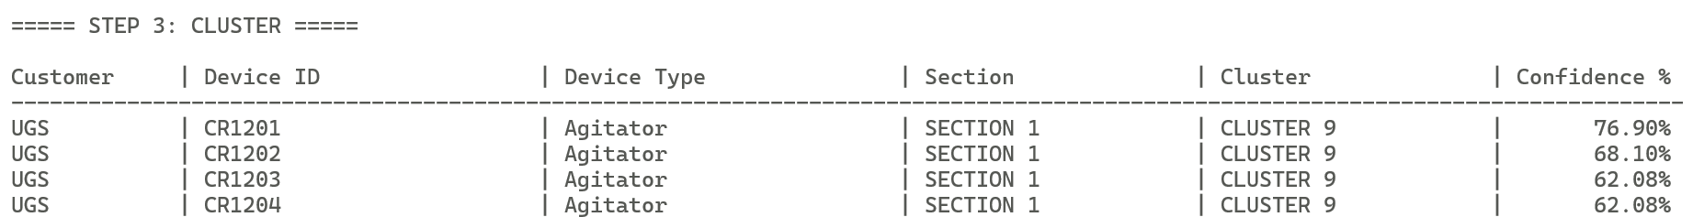
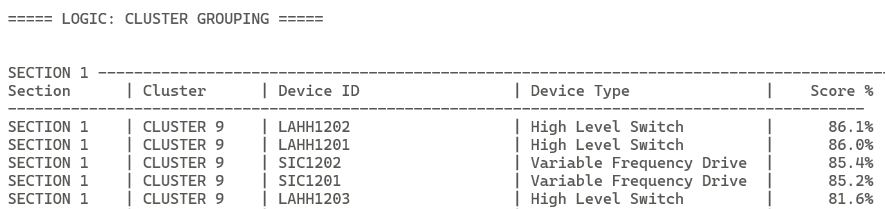
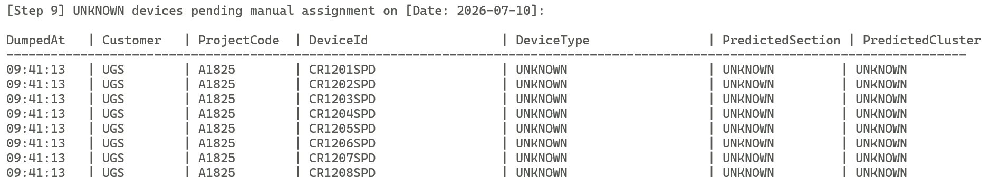
DEVICE TYPE
DEVICE SECTION
DEVICE CLUSTER
SECTION CLUSTER
GROUPING
UNKNOWN

Slide 4
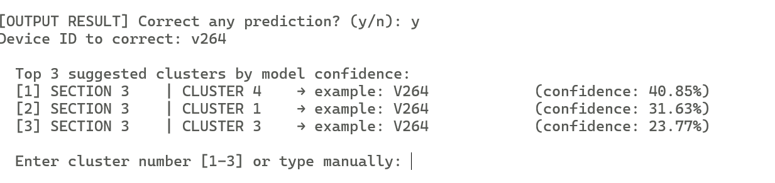
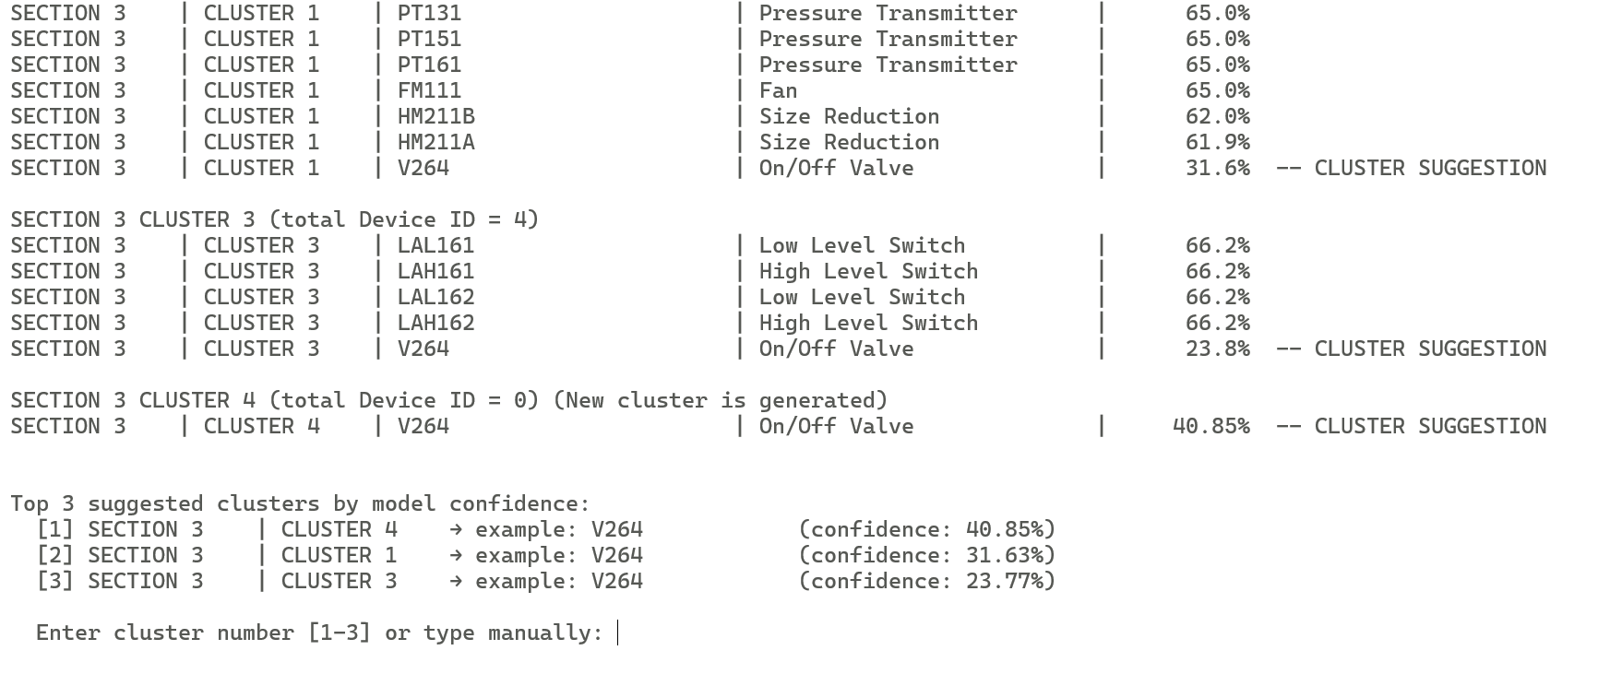
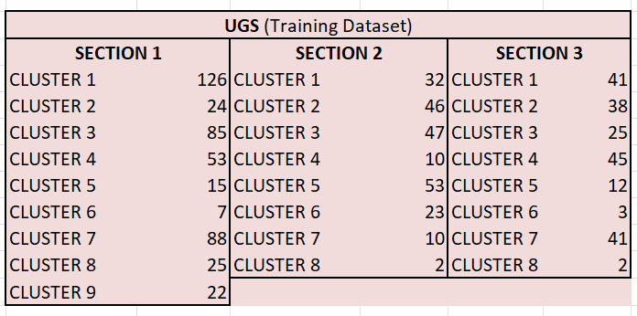
Assign Device Section
Suggestion top 3 from model
In the output suggestion, only existed 2 CLUSTER : - SECTION 3 CLUSTER 1
SECTION 3 CLUSTER 3
Q : where is coming SECTION 3 CLUSTER 4 as per suggested?
A : From training dataset
Q : Is it come from UGS? Or it belong to others client?
A : Training data used UGS & OILTEK
Q : is SECTION 3 CLUSTER 4 existed in UGS training data? = YES
Q: should include together the training dataset from the similar client?
A = as for now, EXCLUDED!
Restructure and Kick
PROBLEM : Depends on the training dataset.
EXAMPLE : V264

Slide 5
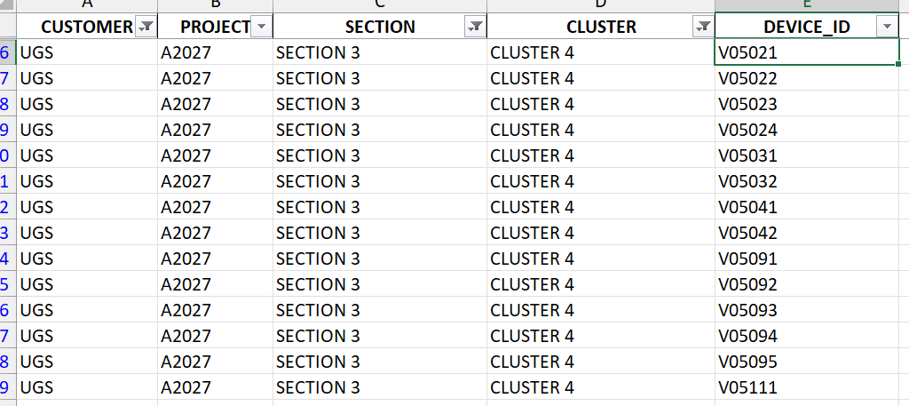
From training dataset.
All SECTION 3 CLUSTER 4 refer to “V”
All contain 1 similar devices
(refer to On/Off Valve)

Slide 6
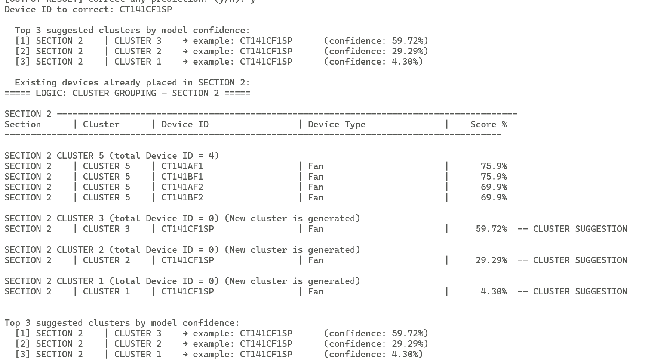
EXAMPLE 2 : CT141CF1SP

Slide 7
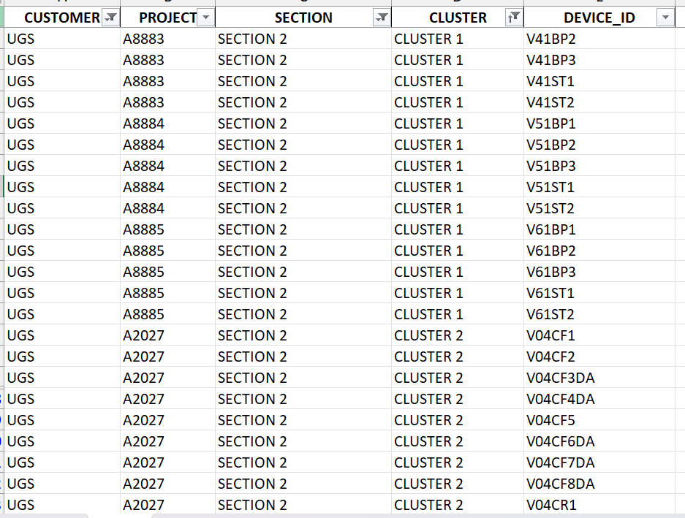
EXAMPLE 2 : CT141CF1SP

Slide 8
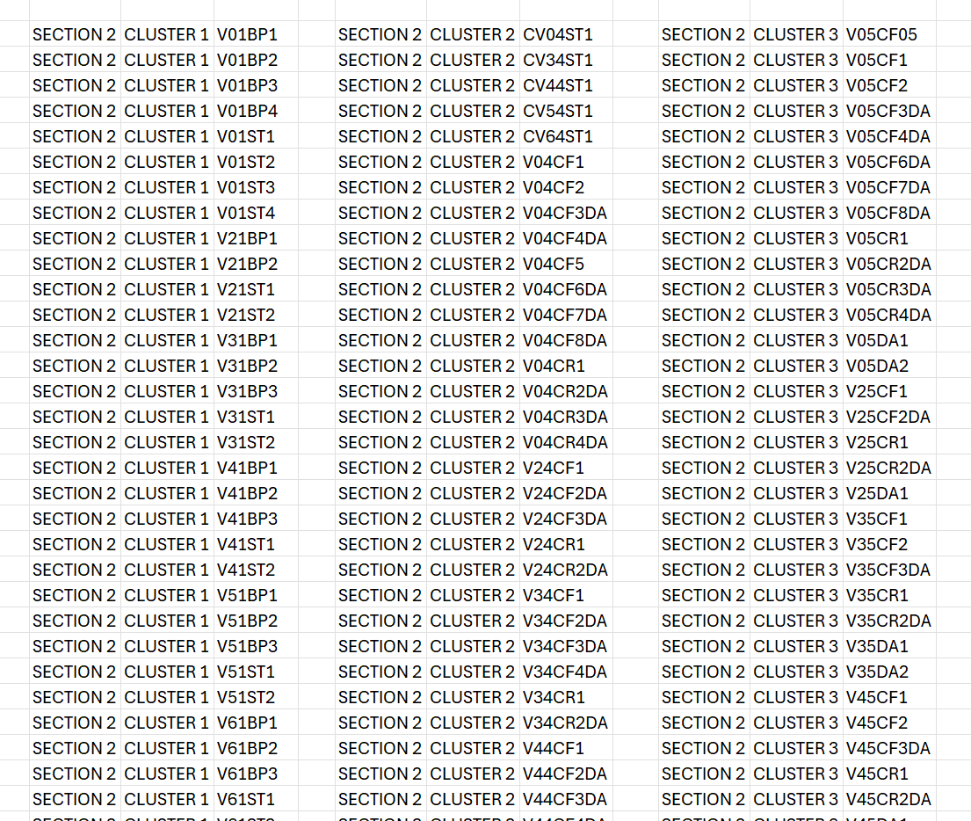
DISTRIBUTION OF THE DATASET
SECTION 2 CLUSTER 1
32 ITEM OF V
(On/off valve)
SECTION 2 CLUSTER 47 V (On/off valve)
SECTION 2 CLUSTER 2
5 CV (control valve)
41 V (On/off valve)

Slide 9
THE END

Slide 10
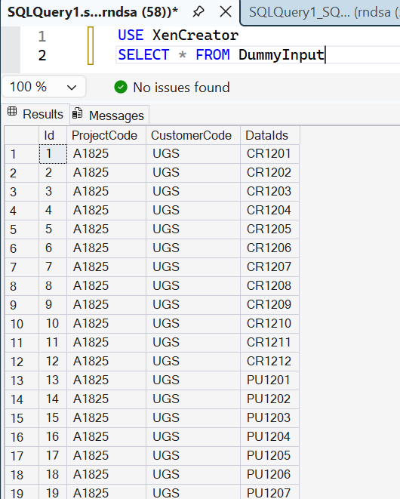
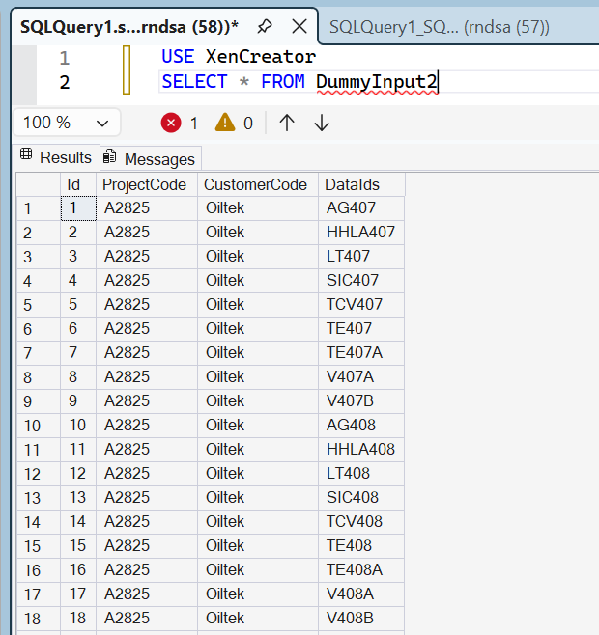

Slide 11
GENERATED ON 14/07/2026
TRAINING DATASET
OILTEK
A1706 (REFERENCE)
A9991, A9992, A9993, A9994, A9995
UGS
A2027 (REFERENCE)
A8881, A8882. A8883, A8884, A8885
MODEL APPLICATION BY Program.cs
OILTEK
A1706
OUTPUT :
TOTAL DEVICE ID = 128 ID
KNOWN = 117 ID
UNKNOWN = 11 ID

Slide 12
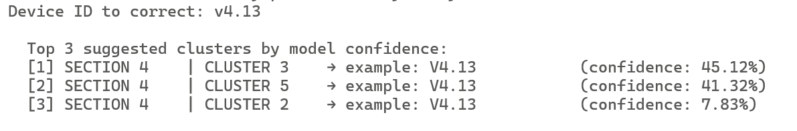
GENERATED ON 14/07/2026
V4.13 – SECTION4 CLUSTER?

Slide 13
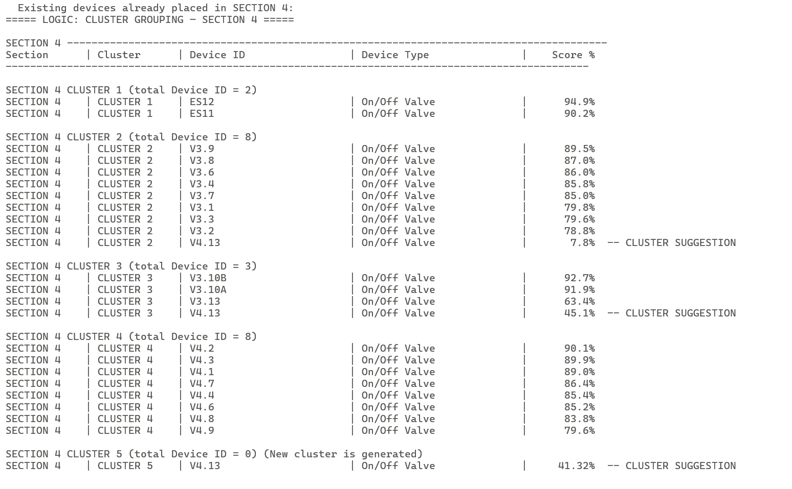
GENERATED ON 14/07/2026
V4.13 – SECTION4 CLUSTER?

Slide 14
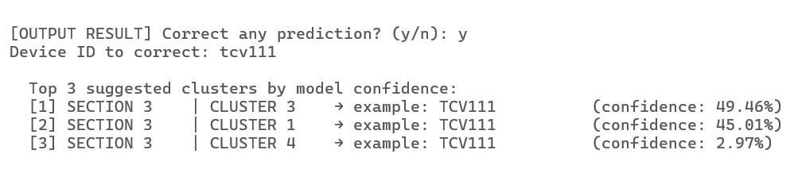
GENERATED ON 14/07/2026
TCV111 – SECTION 3 CLUSTER?

Slide 15
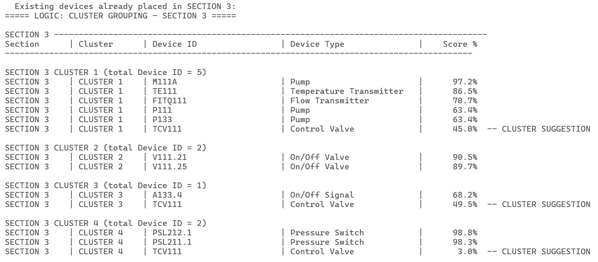
GENERATED ON 14/07/2026
TCV111 – SECTION 3 CLUSTER?

Slide 16
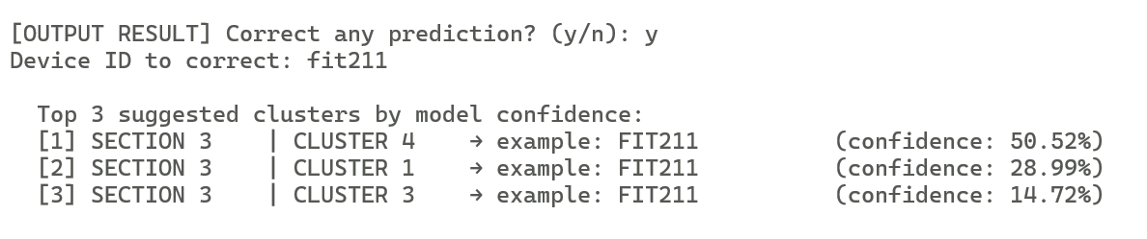
GENERATED ON 14/07/2026
FIT211 – SECTION3 CLUSTER?

Slide 17
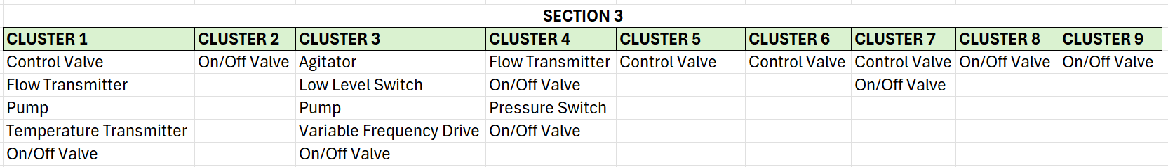
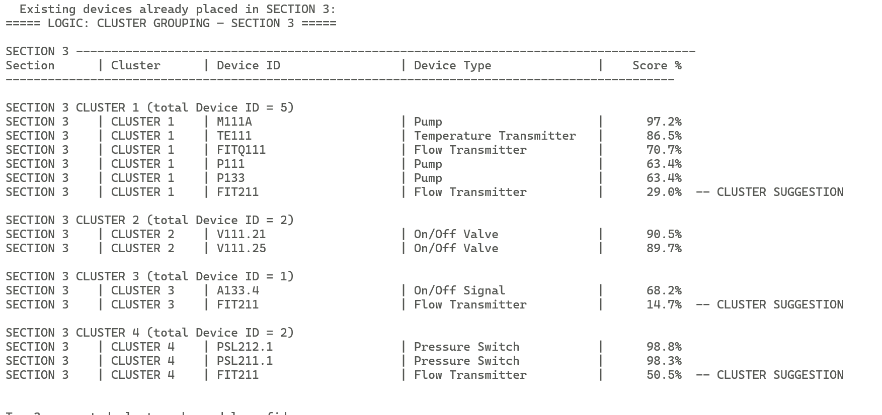
GENERATED ON 14/07/2026
FIT211 – SECTION3 CLUSTER?

Slide 18
GENERATED ON 15/07/2026
SECTION3 OILTEK

Slide 19
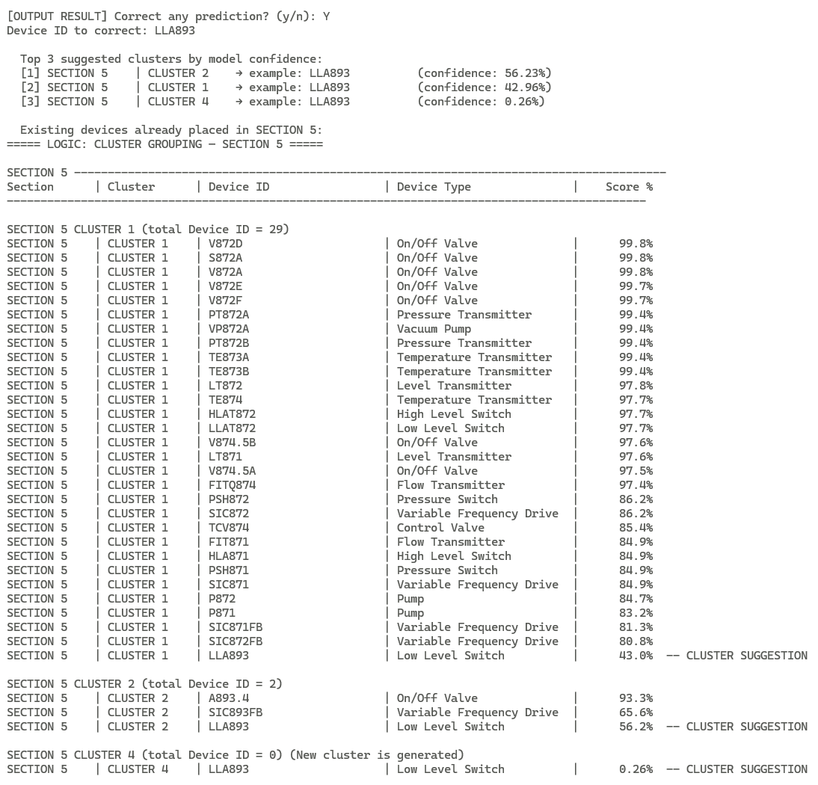
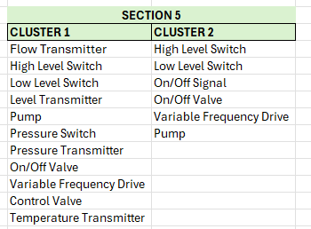

Slide 20
Case when :
Check the top 3 highest percentage
Load the top 3 cluster obtain from the highest percentage
Match the pattern algorithm.
Is the equipment existed in the cluster algorithm reference? Yes/No
NO = EXCLUDE THE CLUSTER
YES = Proceed with the selection.
If there is more than 1 similar device type across cluster, which cluster should choose? = choose the cluster in which no Device Type inside.
QUESTION! WHEN THE KICK AND REPLACE WILL WORK?

Slide 21
STAGE 1
Highest Percentage

Slide 22
GENERATED ON 14/07/2026
DRAFT ALGORITHM

Slide 23
OBSOLETE

Slide 24
MACHINE LEARNING PIPELINE
INPUT
(Customer, Project, Device ID)
CREATE ON (18.03.2026)
UPDATE ON (20.0.2026)
NEW LIST EQUIPMENT
ML MODEL
UPDATE & SAVE MODEL
PREFIX
SUFFIX
SGD Classifier Hybrid Model
- SGD Classifier
- Composite Similarity
XGBoost
DBScan
Device Type
Section
Cluster
UNKNOWN
= Assign by User
RESULT OUTPUT
(Customer, Project, Device ID, Device Type, Section)
UPDATE & SAVE MODEL

Slide 25
MACHINE LEARNING PIPELINE
INPUT
(Customer, Project, Device ID)
UPDATE ON (16.04.2026)
1
ML MODEL
RETRIVE
[new_equipment.pkl]
SGD Classifier
XGBoost
NEW LIST OF EQUIPMENT
3
Data type
Cluster
Section
UNKNOWN
= Assign by User
RESULT OUTPUT
(Customer, Project, Device ID, Section, Cluster)
2
Process flow
(1) Input - Model – Result Output – Update & Save Model
(2) Input - Model - Output (UNKNOWN) - Assign by user – New Equipment Data
- Model – Update & Save Model
(3) New Equipment Data - Model - Update & Save Model
UPDATE & SAVE MODEL

Slide 26
MACHINE LEARNING PIPELINE
UPDATE ON (15.06.2026)
INPUT from DB
(Customer, Project, Device ID)
1
ML MODEL
RETRIVE
[new_equipment.pkl]
SGD Classifier
XGBoost
NEW LIST OF EQUIPMENT
3
Data type
Cluster
Section
UNKNOWN
= Assign by User
RESULT OUTPUT
(Customer, Project, Device ID, Section, Cluster)
2
UPDATE & SAVE MODEL

Slide 27
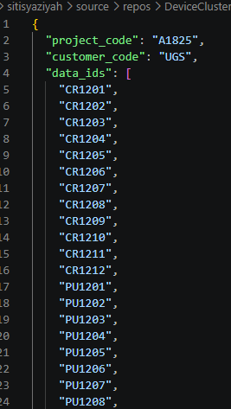
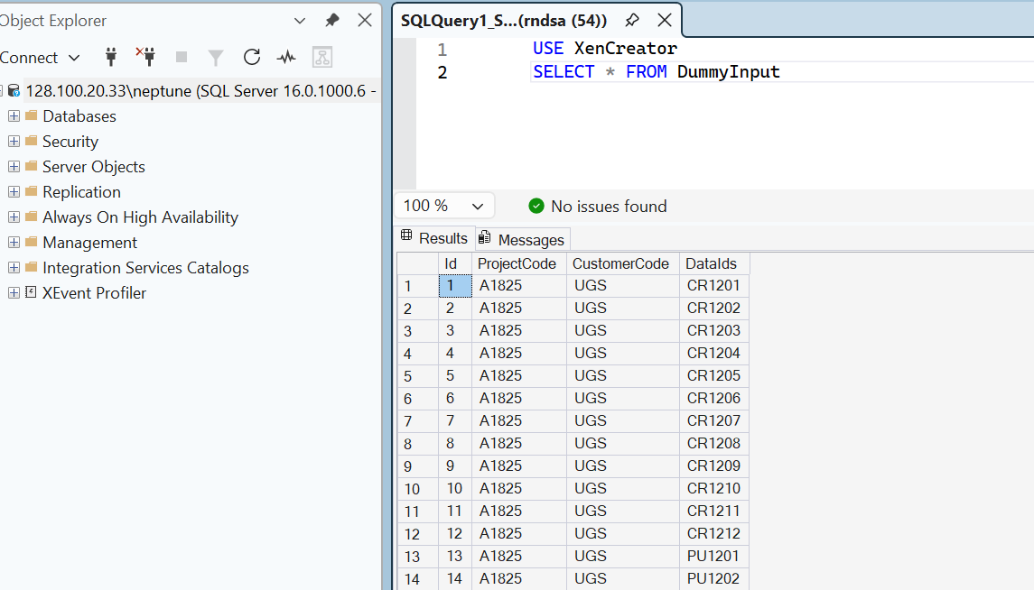
SQL : From DB to Json

Slide 28
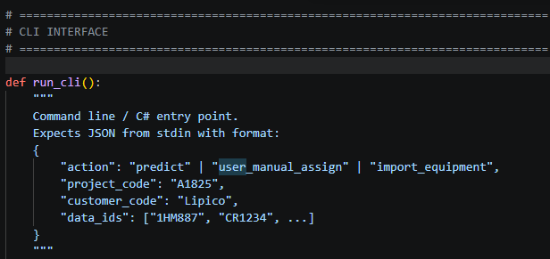

Slide 29
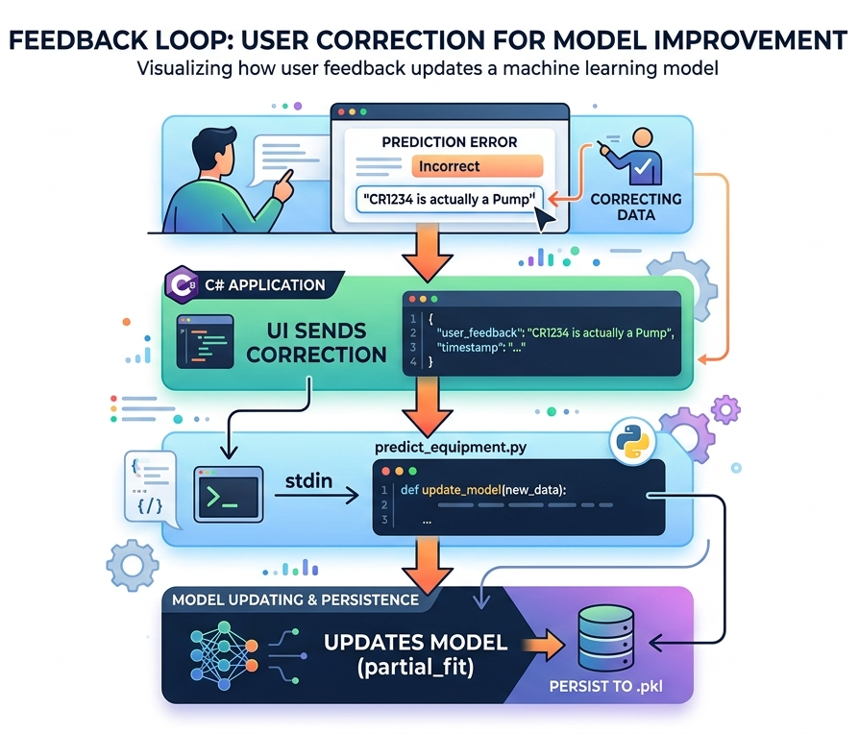
manual assign
type, section, cluster
workflow

Slide 30
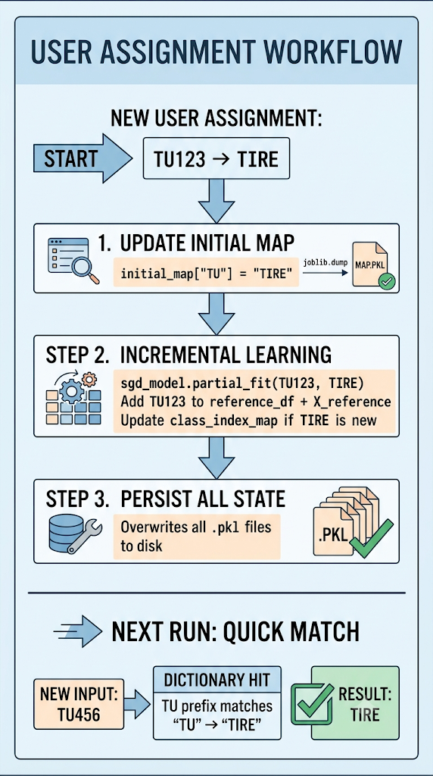
manual assign
type, section, cluster
workflow

Slide 31
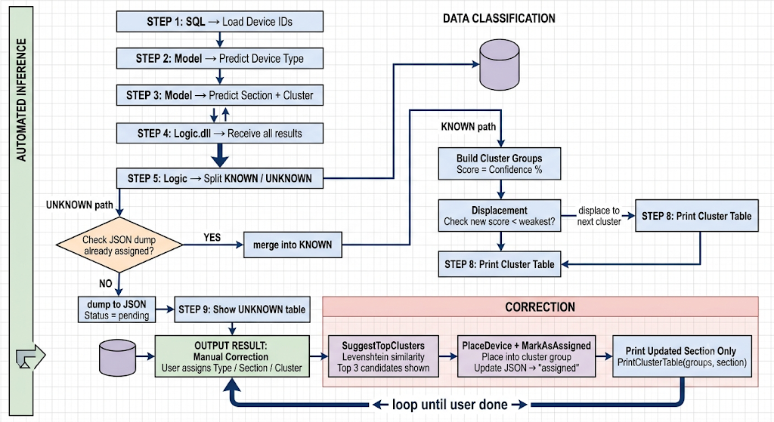

Slide 32
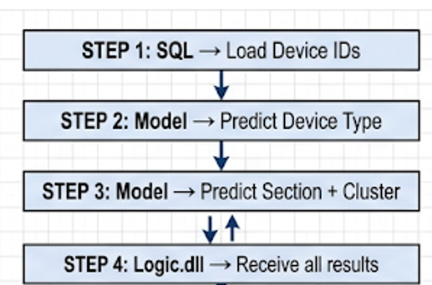
UNKNOWN
Pending Table (JSON dump)
KNOWN
CLUSTERED GROUP (Table)
User Assign
yes
no
Suggestion similarity
(section, cluster)
Type – auto save
Remain in JSON dump
User Assign

Slide 33
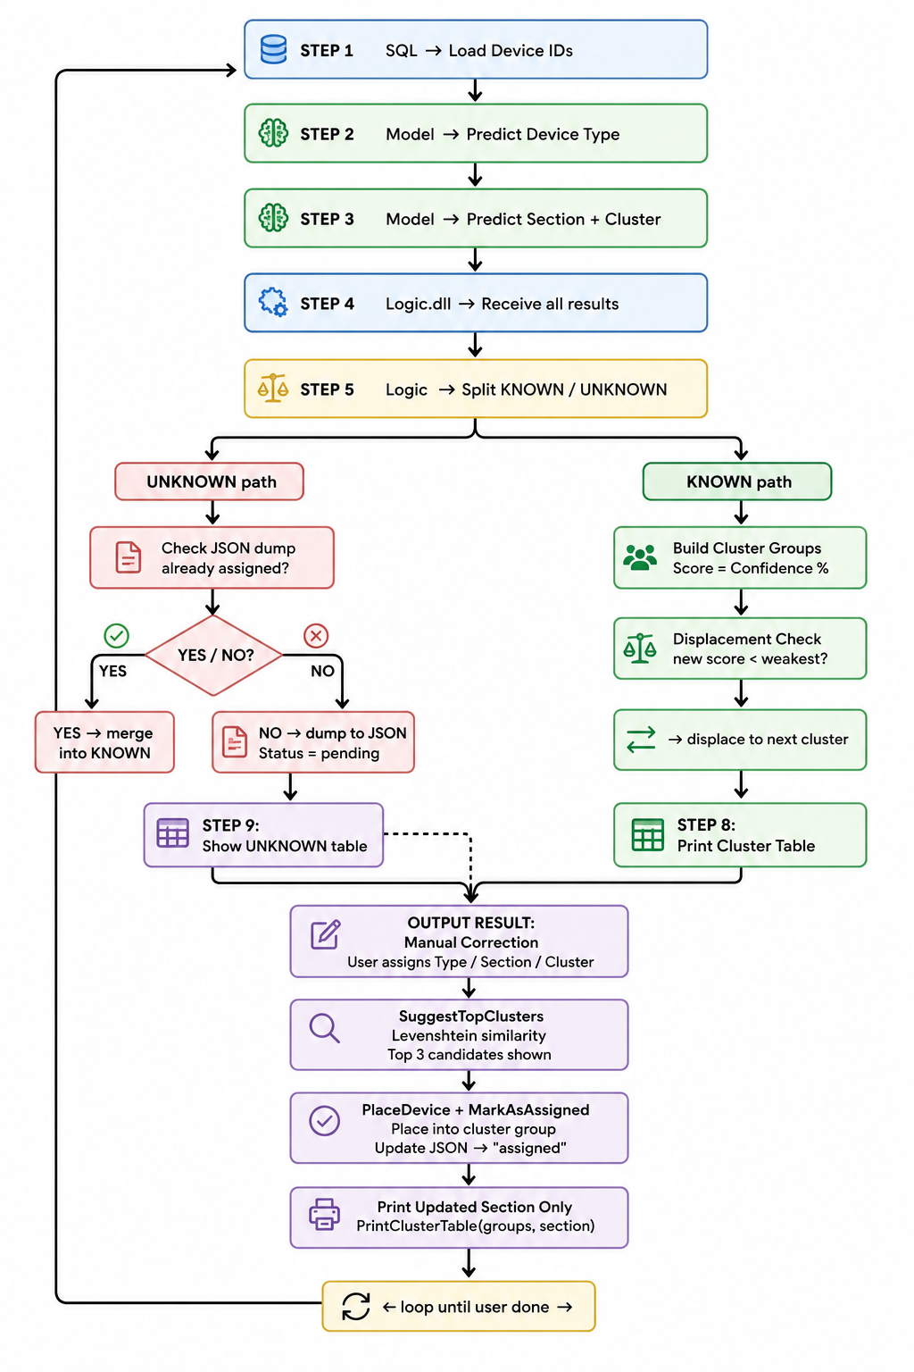

Slide 34
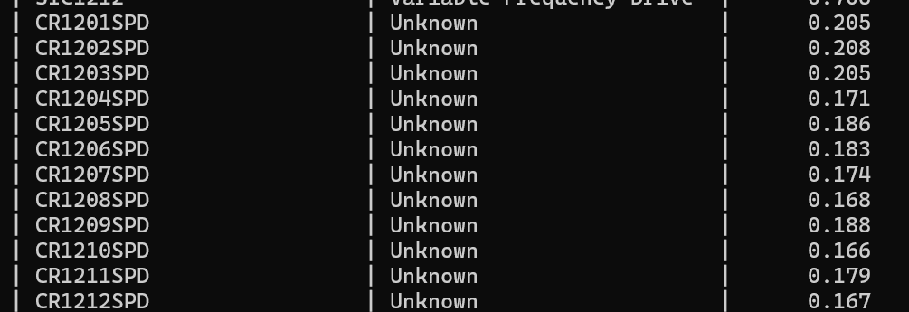
Source Project A1825 - LIPICO : CR___SPD refer to Control Valve/VSD.
But for CR refer to agitator. Hence the model unable to captured what is the right device type for this

Slide 35
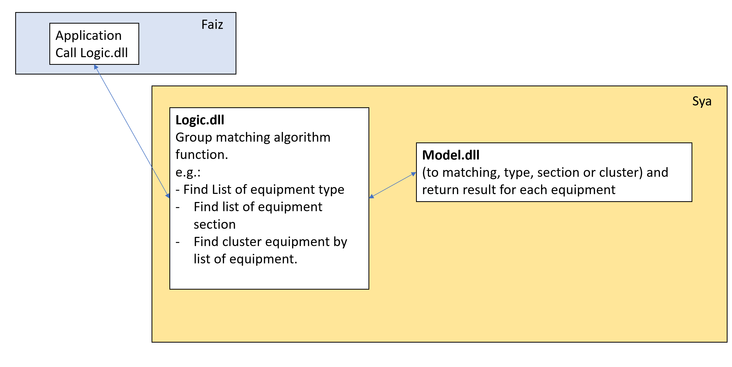

Slide 36
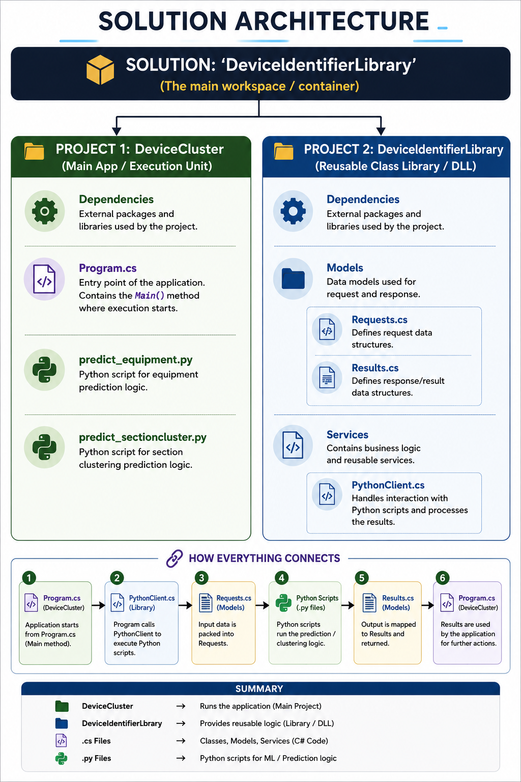
DeviceIdentifierLibrary
workflow

Slide 37
Training model
(N = 1132)
Remove duplication = 1123
Training = 786
Validating =168
Testing = 169
reference_df
(N = 1321)
master_df
(N = 1321)
Model Application
(N = 385)
Known = 250
UNKNOWN= 135
UNKNOWN
(N = 135)
DeviceType = 23
DeviceSection = 6
DeviceCluster = 106 [PREDICTION % BY THE MODEL]
= suggest % the top 3
Action = remove the LV distance and similarity

Slide 38
DeviceCluster -
Logic.dll
AppRegistryEditor
DeviceCluster
[PROJECT CONSOLE]
Test all the function to makesure it works
Show the UI in console apps

Slide 39
DeviceCluster
[PROJECT CONSOLE]
Load SQL
Predict Type
Predict Section
Predict Cluster
Logic – Cluster Grouping
Logic – UNKNOWN
Assign Device Type
Assign Device Section
Assign Device Section
Save
Save
Suggestion top 3 from model
Restructure and Kick

